Slide 1
Circulatory disturbances
Assistant Professor
Dr. Jihad A. Ahmed
VMD, Ph.D. Pathology

Slide 2
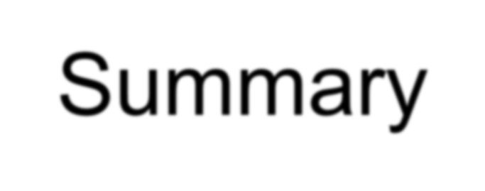
1. Edema
2. Hyperemia and Congestion
3. Hemorrhage
4. Shock

Slide 3
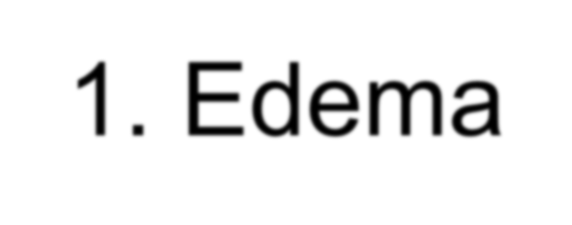
Edema means increased ↑ fluid in the interstitium
cavities – hydrothorax, hydropericardium, ascites
anasarca = severe generalized edema
3 major factors:
hydrostatic pressure
plasma colloid osmotic pressure
lymphatic drainage
inflammation

Slide 4
1. increase ↑ hydrostatic pressure
impaired venous return
congestive heart failure
constrictive pericarditis
liver cirrhosis – ascites
venous obstruction or compression
thrombosis
external pressure

Slide 5
2. Decrease ↓ Plasma colloid osmotic pressure
loss or reduced albumin synthesis
nephrotic syndrome
protein-losing gastroenteropathy
liver cirrhosis
malnutrition

Slide 6
3. lymphatic obstruction
→ lymphedema
inflammatory → elephantiasis
Filariasis - Wuchereria bancrofti
Erysipelas – Streptococcus pyogenes
neoplastic – breast carcinoma (orange peel skin)
post-surgical (LN resection) + postirradiation

Slide 7
Hyperemia and congestion mean increased↑ blood volume in particular tissue
a. hyperemia – active (arteriolar dilation)
red color
striated muscle exercise
b. congestion – passive (impaired venous return)
systemic x local
blue-red color (cyanosis), edema
event. hypoxemic necrosis, e.g. bowel
accumulation of deoxygenated Hb
chronic → chronic hypoxia → regressive changes + small hemorrhages → siderophages

Slide 8
Hemorrhage is the extravasation of blood from blood vessels
external (+ in hollow organs)
internal: within tissue – hematoma
hemorrhagic diatheses – insignificant injury
vasculopathies
trombocytopenia + -patia
coagulopathy

Slide 9
Hemorrhage is classified into four types (types of hemorrhage)
1. Petechiae (1-2 mm) - skin + mucosa
increase ↑ intravascular pressure, decrease ↓ platelets
2. Purpuras (3-5 mm)
trauma, vasculitis, vascular fragility
3. Ecchymosis (1-2 cm) = hematoma (bruise)
RBC phagocytosis by macrophages
Hb (red-blue) → bilirubin (blue-green) → hemosiderin (golden-brown)
4. According to the location in the Cavities
hemothorax, hemopericardium, hemoperitoneum
hemarthros

Slide 10
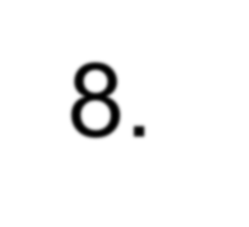
Shock means systemic hypoperfusion due to a reduction of cardiac output / effective blood volume circulation
hypotension → cellular hypoxia
features – hypotension, tachycardia, tachypnea, cool cyanotic skin (x septic s. – warm)
initial threat + shock manifestations in organs
prognosis
– origin + duration

Slide 11
Shock classified into 5 types (types of shock)
1. Cardiogenic shock: failure of myocardial pump
myocardial infarction, arrhythmias
pulmonary embolism
2. Hypovolemic shock: inadequate blood/plasma volume
hemorrhage
fluid loss (vomiting, diarrhea, burns, trauma)
3. Septic shock: vasodilation + endothelial injury
Gram+, Gram-bacteria
4. Neurogenic shock: loss of vascular tone
spinal cord injury
5. Anaphylactic shock: as IgE–mediated hypersensitivity

Slide 12
Thank you

